Slide 1
ANALYZING AMAZON SALES DATA
D e t a i l e d
P r o j e c t
R e p o r t
PROHIT RATHOD

Slide 2
PROJECT DETAIL
Project Title | Analyzing Amazon Sales Data
Technology | Business intelligence
Domain name | E-Commerce
Project Difficulties Level | Advanced
Tools | Jupyter notebook, Power Bi, Ms Excel, Ms PowerPoint

Slide 3
OBJECTIVE
Finding Sales & Profit Trend month wise , year wise , yearly month wise

Slide 4
PROBLEM STATEMENT
Sales management has gained importance to meet increasing competition and the need for improved methods of distribution to reduce cost and to increase profits. Sales management todayis the most important function in a commercial and business enterprise.
Do ETL : Extract-Transform-Load some Amazon dataset and find for me Sales-trend -> monthwise , year wise , yearly-month wise
Find key metrics and factors and show the meaningful relationships between attributes.

Slide 5
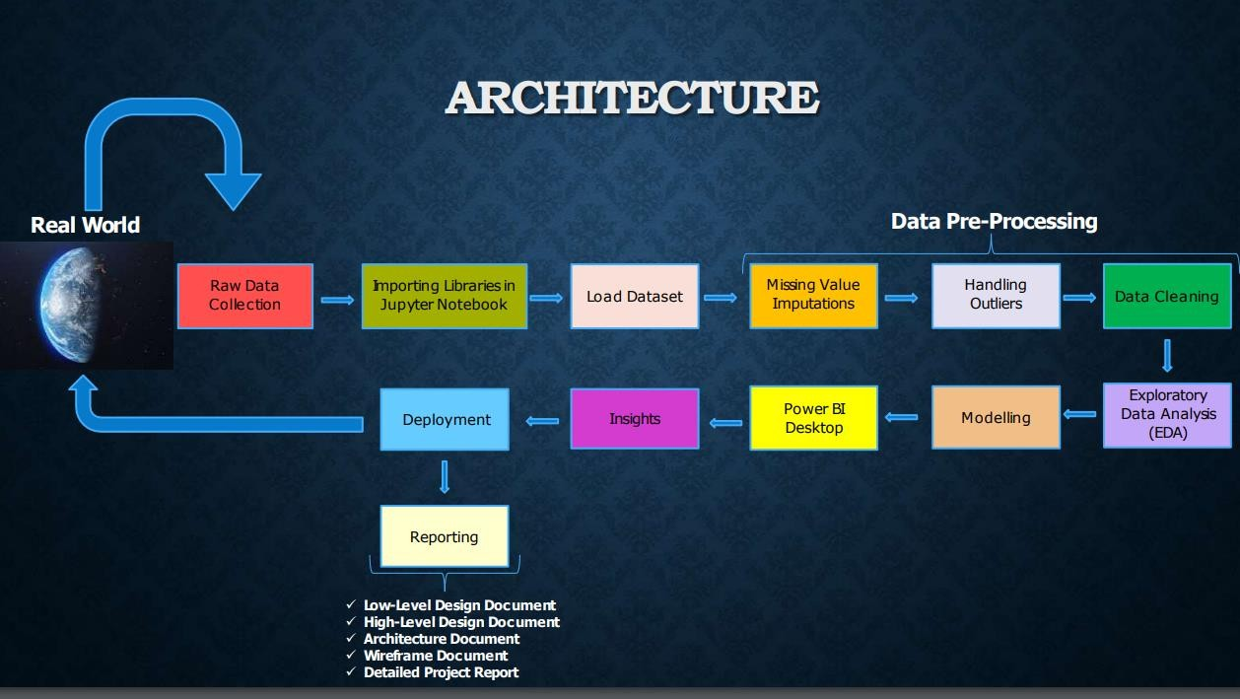

Slide 6
DATASET INFORMATION
This is a Sales related dataset that contains Information like Sales Amount, Cost Amount, Sales Prices, List Prices, Sales Margins, Sales Quantities, etc.

Slide 7
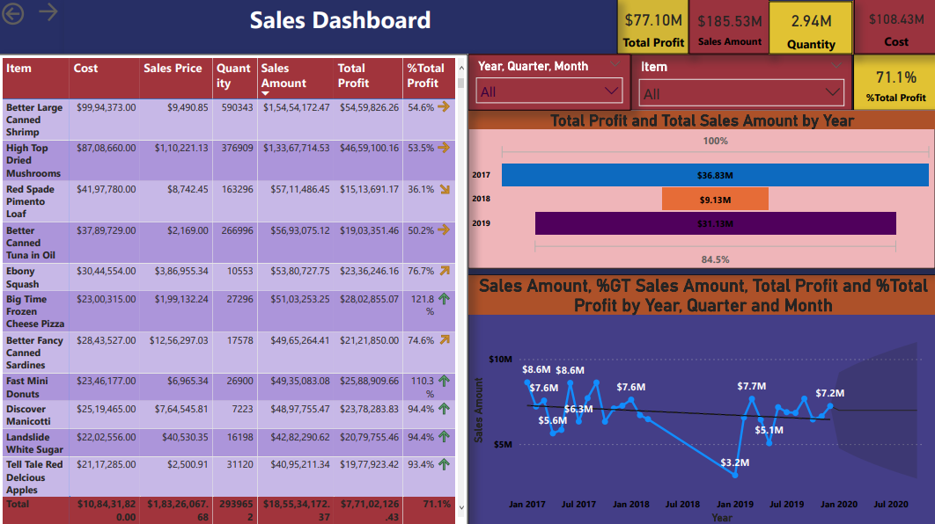
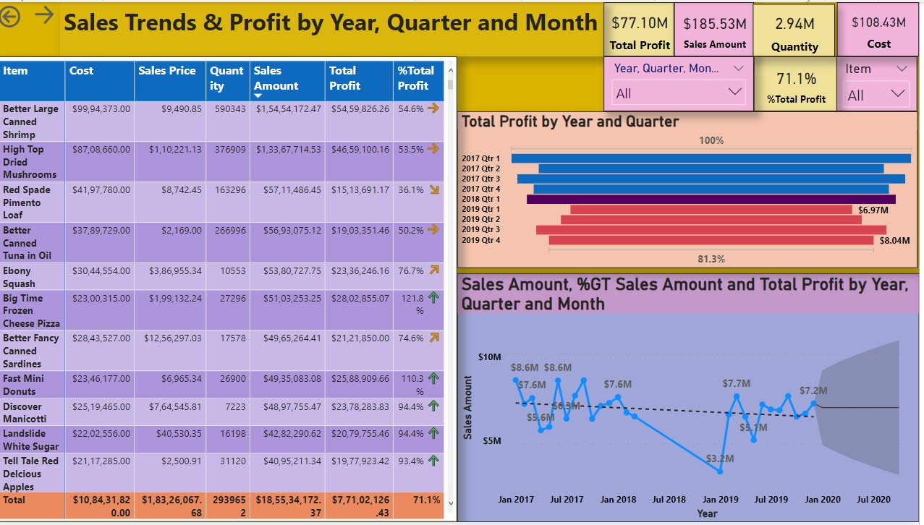
Sales and Profit Analysis
At $1,54,54,172.47, Better Large Canned Shrimp had the highest Sales and was 7,549,200.21% higher than Kiwi Lox, which had the lowest Sales at $204.71. Better Large Canned Shrimp accounted for 8.51% of Sales. Profits trended down, resulting in a 16.16% decrease between 2017 and 2019. It trended down, resulting in a 21.15% decrease and dropped from
$9,598,696.65 to $7,568,565.85 during its steepest decline between January 2017 and October 2019.

Slide 8
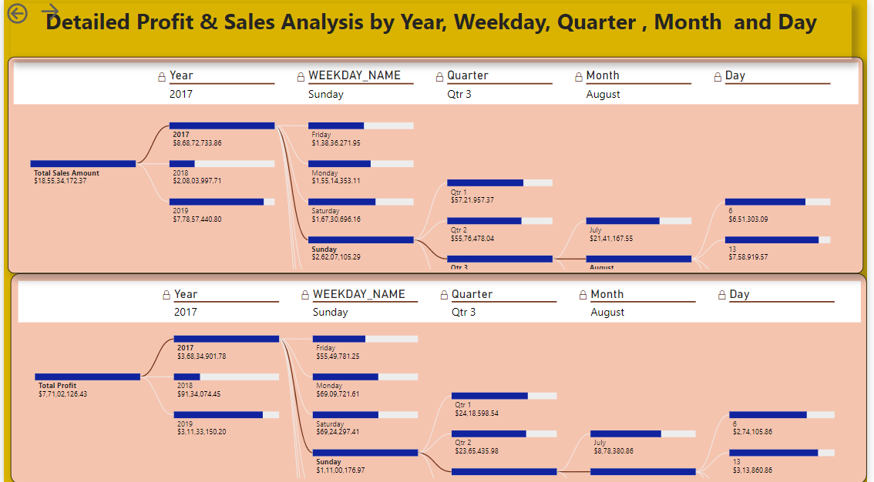
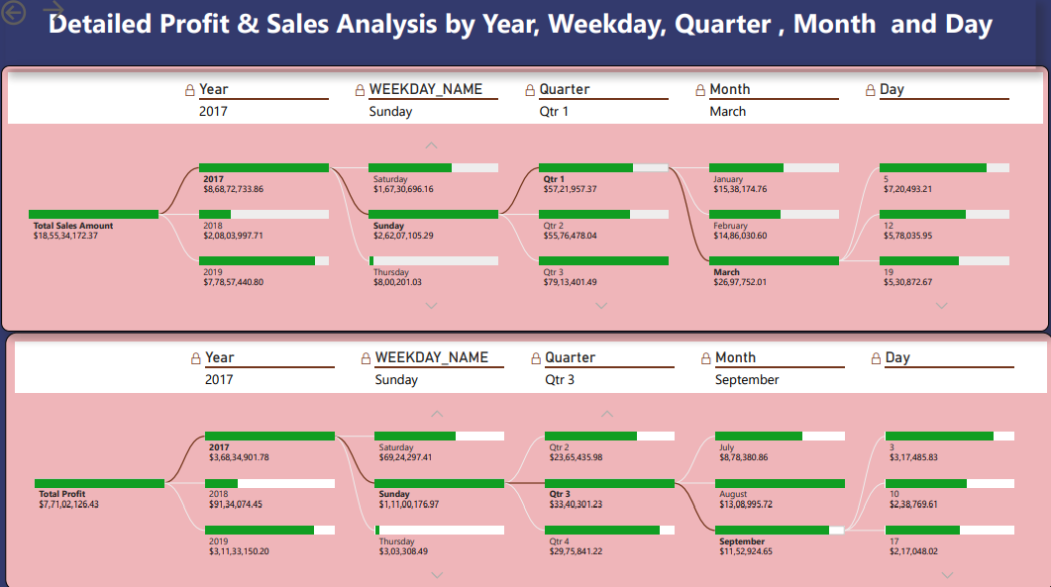
In this Decomposition Tree visual, we can Analyze how much Sales & Profits were made from 2017 to 2019.Comparing 3 Years, 2017 was the year in which highest Sales & Profits were made, which was $8,68,72,733.86 and $3,68,34,901.78 respectively. Sales and Profit was maximum on Sunday, which was $2,62,07,105.29 and, $1,11,00,176.97 respectively. Sales & Profits were very balanced in all 4 Quarters but it was highest in Q3(Sales= $79,13,401.49, Profit= $33,40,301.23). August was the month in which the highest Sales & Profits were recorded, which was $30,74,481.93, $13,08,995.72 respectively. In that Month Sales & Profits were generated on the 6th,13th,20th, 27th day.

Slide 9
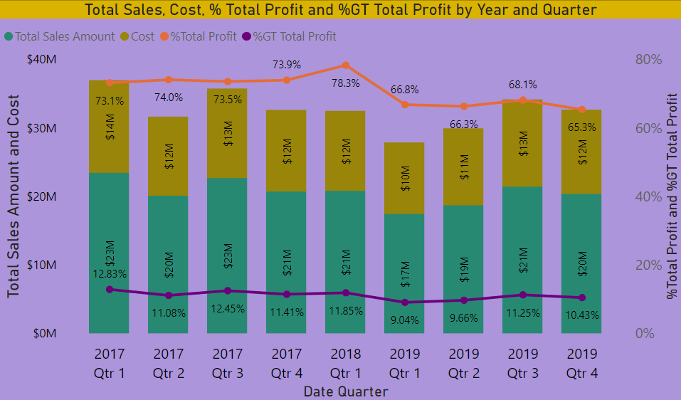
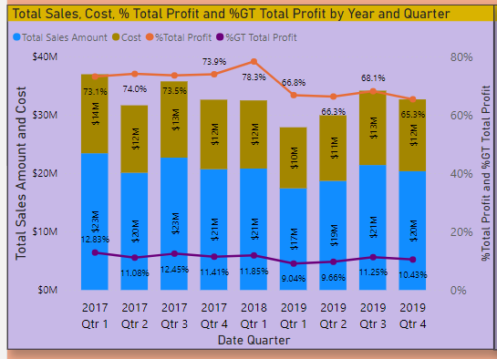
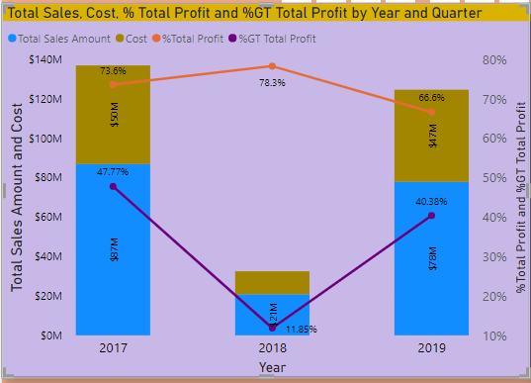
In 2017 Revenue was $8,68,72,733.86 and Profit was $3,68,34,901.78 which was 73.68% of Cost Amt. and it was 47.7% of Grand Total Profit. In 2018 Revenue was $2,08,03,997.71 and Profit was $91,34,074.45 which was 78.34% of Cost Amt. and it was 11.85% of Grand Total Profit. In 2019 Revenue was $7,78,57,440.80 and Profit was $3,11,33,150.20 which was 66.62% of Cost Amt. and it was 40.38% of Grand Total Profit.

Slide 10
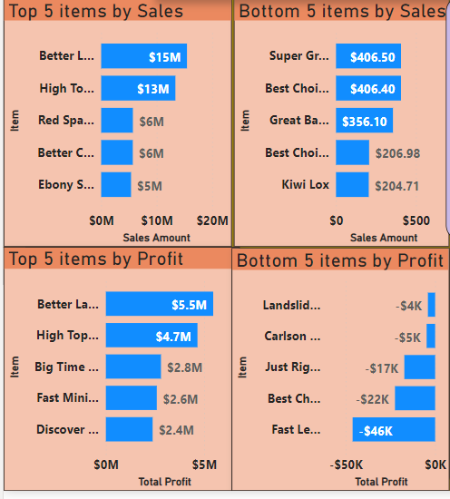
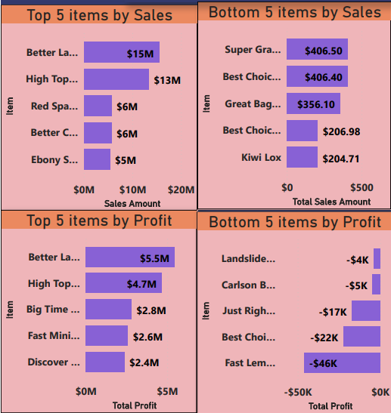
At $1,54,54,172.47, Better Large Canned Shrimp had the highest Sales and was 187.21% higher than Ebony Squash, which had the 5th highest Sales at $53,80,727.75. Better Large Canned Shrimp accounted for 33.89% of Sales. Across all 5 Items, Sales ranged from $53,80,727.75 to $1,54,54,172.47.
At $54,59,826.26, Better Large Canned Shrimp had the highest Profits and was 127.24% higher than Discover Manicotti, which had the 5th highest Profits at $23,78,283.83. Better Large Canned Shrimp accounted for 30.52% of Profits. Across all 5 Items, Profits ranged from $23,78,283.83to $54,59,826.26.
At $406.50, Super Grape Preserves had the 5th lowest Sales and was 63.47% higher than Kiwi Lox, which had the lowest Sales at $204.71. Super Grape Preserves accounted for 25.12% of Sales. Across all 5 Item, Sales ranged from $204.71 to $4.6.50.
At $4,026.61, Landslide Low Fat Apple Butter had the 5th highest Loss and was 91.27% higher than Fast Lemon Cookies, which had the Highest Loss at $46,106.59.Fast Lemon Cookies accounted for 31.9 % of Loss. Across all 5 Item, Loss ranged from ($46,106.59) to ($4,026.61).

Slide 11
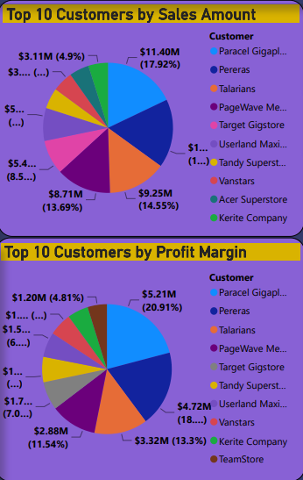
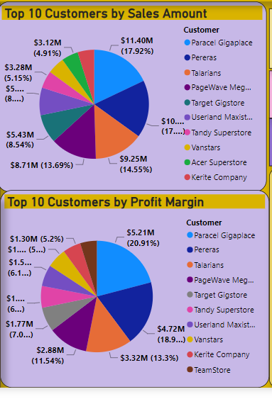
At $1,13,97,206.36, Parcel Gigaplace (Custkey10021485) had generated highest sales and was 383.63% higher than Target
th
Gigastore (Custkey 10025052, which had the 5 highest sales at $54,33,005.93. 10021485 accounted for 17.92% of total sales. Across all top 10 Customers, sales ranged from $31,13,493.93 to $1,13,97,206.36.
At $52,15,559.07, Parcel Gigaplace (Custkey 10021485) had generated highest profits and was 312.11% higher than Target
th
Gigastore (Custkey10025052), which had the 5 highest profits at $12,00,384.67. Across all top 10 Customers profits ranged
from $12,00,384.67 to $5215559.07.

Slide 12
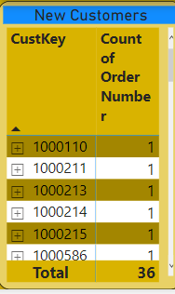
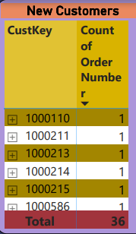
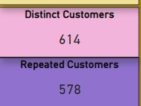
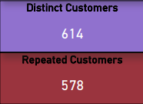
There were total 614 distinct customers. Out of which 578 were the repeat customers and 36 wetre the new customers.

Slide 13
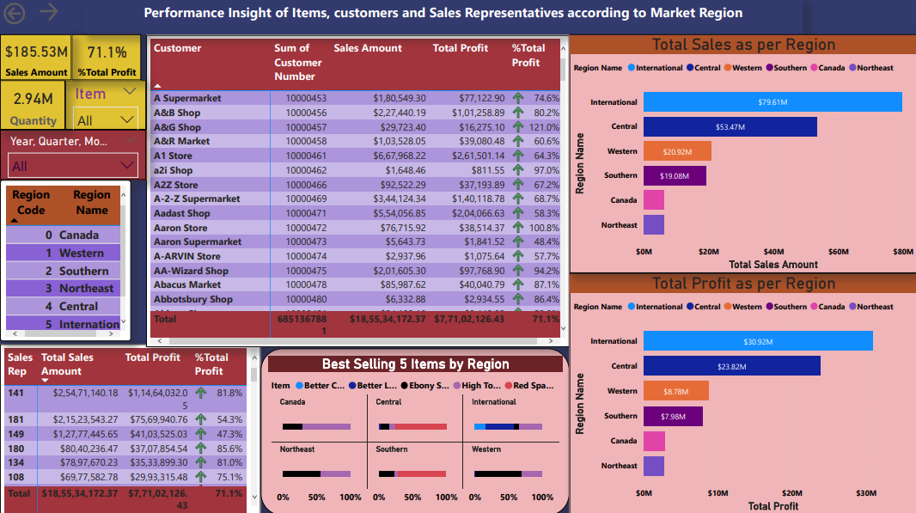
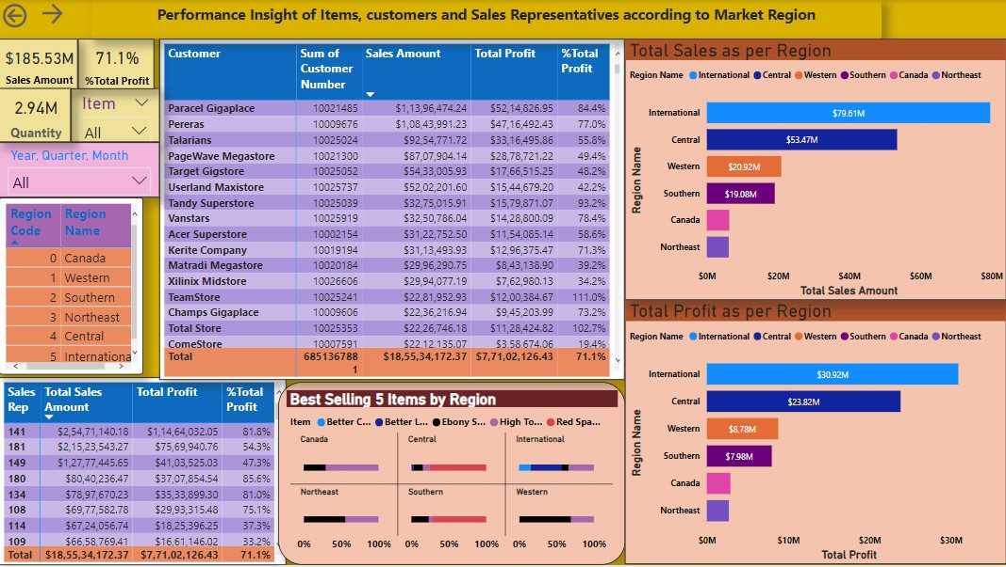
Top 5 best performing sales Representatives as per Sales are 141, 181,149, 180 and 134.
Best Sales sand Profit generating Region is the International Region (Region Code 5) with total sales of $7,96,13,827.90 which is 42.91 % of total sales anfd Profit of $3,09,17,564.52 which is 40.10% of total profit generated.
Northeast ( Region Code 3) is the least sales and profit generating market region with sales of $ 61,52,827.67 which was 3.32% of total sales and Profit was $ 27,08,223.15 which was 3.51 % of total profit generated.

Slide 14
In Canada ( Region Code 0), High top dried Mushroom is the best selling Item.
In Western Region ( Region Code 1), Ebomy Squash is the best selling Item.
In Southern Region ( Region Code 2), Red Spade Pimanto Loaf is the best selling Item.
In Northeast Region ( Region Code 3), Ebomy Squash is the best selling Item.
In Central Region ( Region Code 4), Red Spade Pimanto Loaf is the best selling Item.
In International Region ( Region Code 5), Better Large Canned Shrimp is the best selling Item.

Slide 15
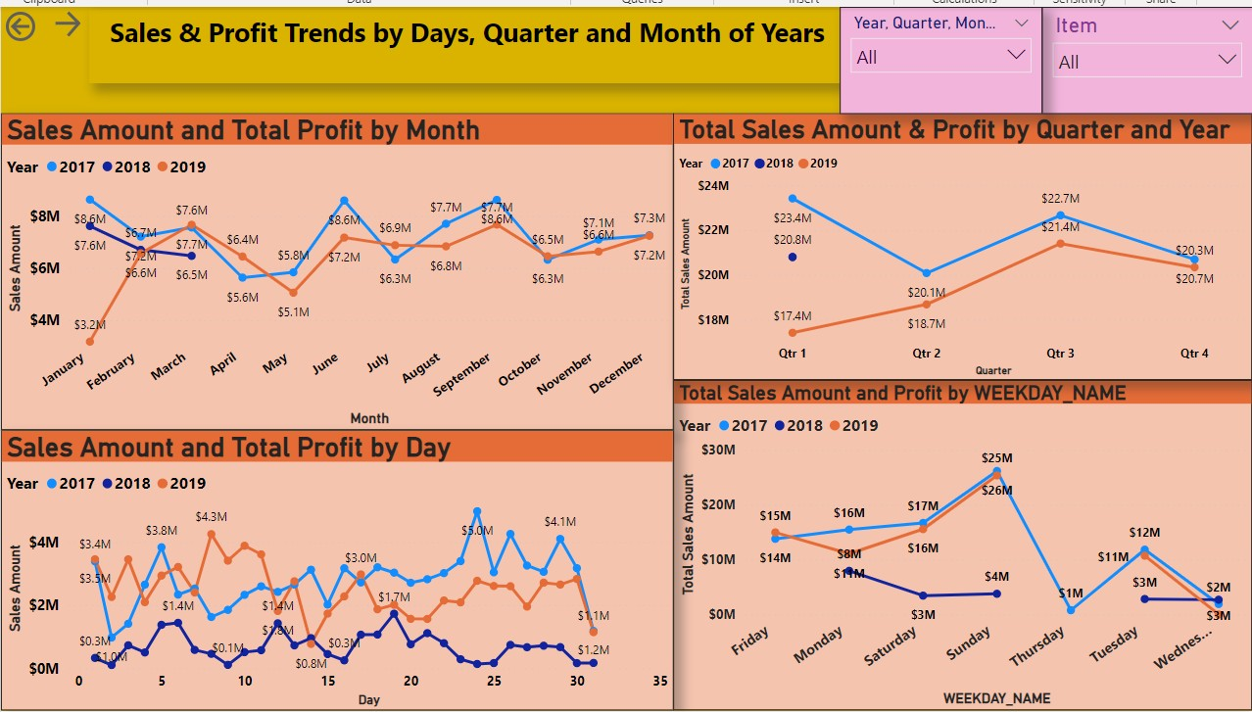
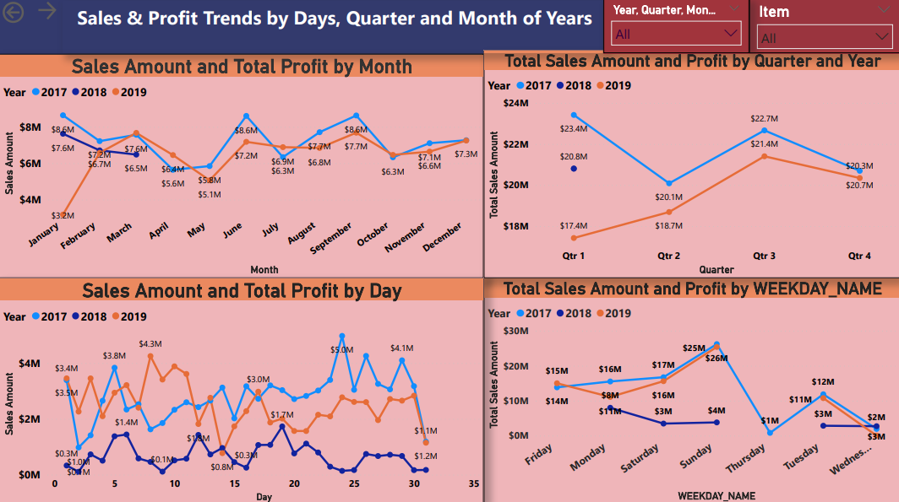
If we Compare Sales for 2017 and Sales for 2018 we found that on 24, 26 and 28 there was largest decline among Days. The relative contributions made by 24, 19, 8 days changed the most.
If we Compare Sales for 2017 and Sales for 2019 we found that in June, August and September, there was largest increase among the months. The relative contributions made by Jan, Feb, Mar changed the most.
Sales trended down, resulting in a 13.34% decrease between January 2017 and January 2018. Sales started trending down in January 2017, falling by 11.15% ($27,25,398.48) in 4 quarters. Sales dropped from $2,34,21,043.50 to $2,06,95,398.02 between January 2017 and December 2017. During its steepest decline between January 2018 and January 2019, Sales

Slide 16
dropped from $76,22,864.17 to $31,16,722.21. Sales trended down, resulting in a 5.06% decrease between January 2018 and March 2019. Sales started trending up on April 2019, rising by 6.22% ($11,94,751.71) in 2 quarters. Sales jumped from
$1,86,86,855.92 to $2,14,05,142.50 during its steepest incline between Quarter 2, 2019 and Quarter 3, 2019.
Profits trended down, resulting in a 6.82% decrease between January 2017 and January 2018. Profits started trending down in January 2017, falling by 6.82% ($6,52,731.37) in all 4 quarters. Profits dropped from $35,970,027.18 to $12,79,430.66 during their steepest decline between January 2017 and January2018. Profits trended down, resulting in a 15.16% decrease between January 2018 and October 2019.
At $87,73,249.43, Better Large Canned Shrimp had the highest Sales and was 42,85,596.56% higher than Kiwi Lox, which had the lowest Sales at $204.71. Sales and total Profits are negatively correlated with each other. Better Large Canned Shrimp accounted for 9.10% of Sales. Sales and Profits diverged the most when the Item was Better Large Canned Shrimp when Sales were $57,32,729.64 higher than Profits.

Slide 17
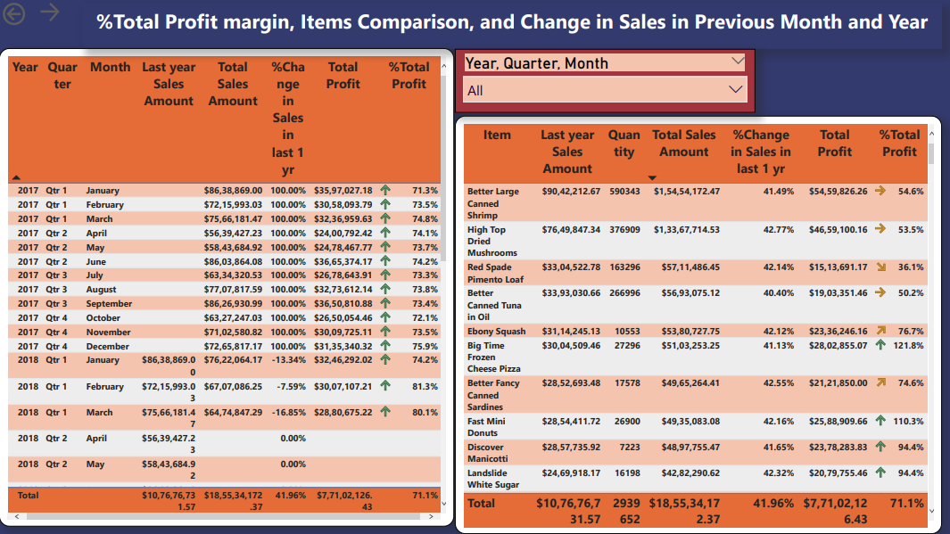
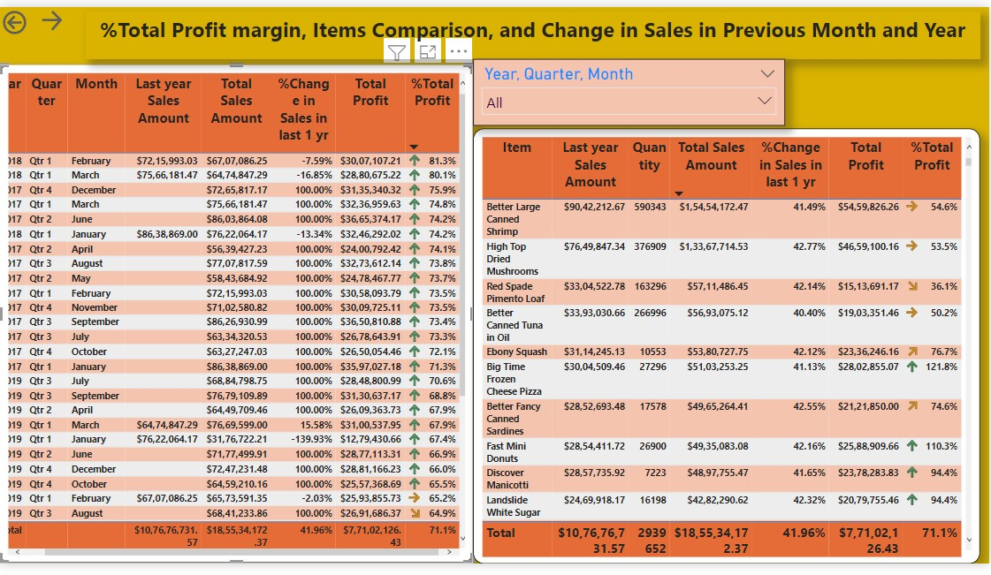

Slide 18
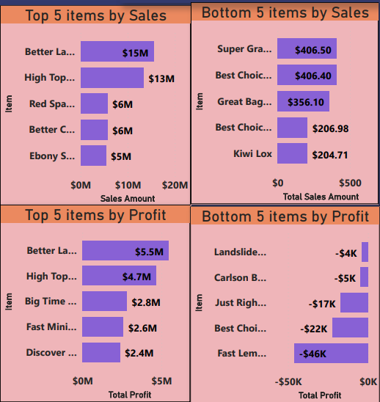
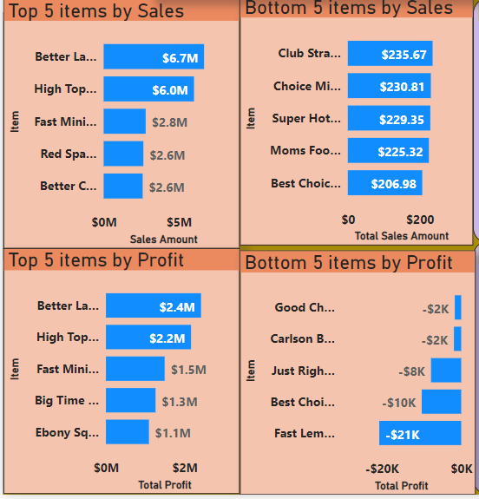
2017
At $66,80,923.04, Better Large Canned Shrimp had the highest Sales and was 157.27% higher than Better Canned Tuna in Oil,
which had the 5th highest Sales at $25,96,886.19. Better Large Canned Shrimp accounted for 32.11% of Sales. Across all 5 Item, Sales ranged from $25,96,886.19 to $66,80,923.04.
At 24,19,306.47, Better Large Canned Shrimp had the highest Profits and was 121.20% higher than Ebony Squash, which had
the 5th lowest Profit at 10,93,739.23. Across all 5 Items, Profits ranged from 10,93,739.23 to 24,19,306.47.
At $235.67, Club Strawberry Yoghurt had the 5th lowest Sales and was 14.51% higher than Best Choice Sesame Crackers, which had the lowest Sales at $206.98. Club Strawberry Yoghurt accounted for 21.62% of Sales. Across all 5 bottom Items, Sales ranged from $206.98 to $235.67. At -$1,610.97, Good Chablis Wine had the 5th lowest Profits and was 94.67% higher than Fast
Lemon Cookies, which had the lowest Profits at -$20,585.56. Across all top 5 Items, Profits ranged from -$20,585.56 to -
$1,610.97.

Slide 19
2018
At $23,61,289.63, Better Large Canned Shrimp had the highest Sales and was 11,78,423.47% higher than Best Choice Low Fat Popcorn, which had the lowest Sales at $200.36. Better Large Canned Shrimp accounted for 11.60% of Sales. Sales and Profits diverged the most when the Item was Better Large Canned Shrimp when Sales were $14,71,795.33 higher than Profits. Better
Large Canned Shrimp had the highest Sales and was 247.42% higher than Discover Manicotti, which had the 5th Highest Sales at $6,79,668.01. Better Large Canned Shrimp accounted for 38.04% of Sales. Across all 5 Item, Sales ranged from $6,79,668.01 to $23,61,289.63.
At $ 8,89,494.30, Better Large Canned Shrimp had the highest Profits and was 169.82% higher than Tell Tale Red Delicious Apples, which had the lowest Profits at $ 3,29,663.79. Across all 5 Item, Profits ranged from $3,29,663.79 to $8,89,494.30. At
$ 86,608, Better Large Canned Shrimp had the highest Quantity sold and was 8,931.07% higher than Discover Manicotti
Quantity sold 959, which had the 5th highest sales. Better Large Canned Shrimp accounted for 61.60% of Quantity. Across all top 5 Items, Quantity ranged from 959 to 86,608. Blue Label Fancy Canned Clams and Cutting Edge Sliced Turkey tied for 4th
lowest Sales at $208.82, followed by Ebony Brocoli at 5th place with sales of $ 210..8 Bravo Canned Tuna in Water. Best Choice Low Fat Popcorn had the lowest Sales at $200.36. Across all 5 Items, Sales ranged from $200.36 to $210.8. At -$ 548.87, Blue Label
Rice Soup had the 5th lowest Profits and was 82.21% higher than Fast Lemon Cookies, which had the lowest Profits at -
$3,085.25. Across all 5 Items, Profits ranged from -$3,085.25 to -$548.87.

Slide 20
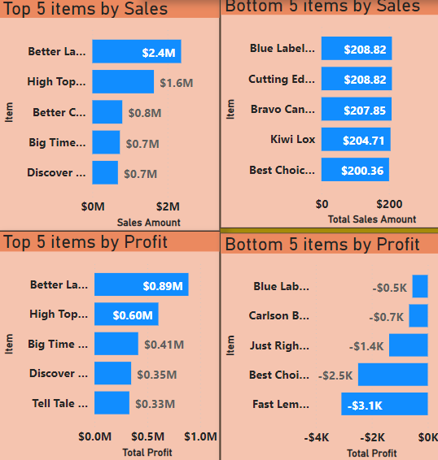
2019
At $64,11,959.80, Better Large Canned Shrimp had the highest Sales and was 31,16,132.41% higher than Special Oatmeal, which had the lowest Sales at $205.76. Better Large Canned Shrimp accounted for 8.43% of Sales, Better Large Canned Shrimp
had the highest Sales and was 182.90% higher than Ebony Squash, which had the 5th lowest Sales at $22,66,482.62. Better Large Canned Shrimp accounted for 33.56% of Sales. At $ 21,51,025.49, Better Large Canned Shrimp had the highest Profits
and was 123.87% higher than Discover Manicotti, which had the 5th highest Profits at $ 9,60,848.73. Across all 5 Item, Profits ranged from $ 9,60,848.73 to $ 21,51,025.49.
At $233.33, Monarch Manicott had the 5th lowest Sales and was 19.67% higher than Special Oatmeal, which had the lowest Sales at $205.76. Monarch Manicott accounted for 21.18% of Sales. Across all 5 Items, Sales ranged from $205.76 to $233.33. At - $ 2,150.52, Good Chablis Wine had the 5th lowest Profits and was 90.41% higher than Fast Lemon Cookies, which had the
lowest Profits at -$ 22,435.78. Across all 5 Items, Profits ranged from -$ 22,435.78 to -$ 2,150.52.

Slide 21
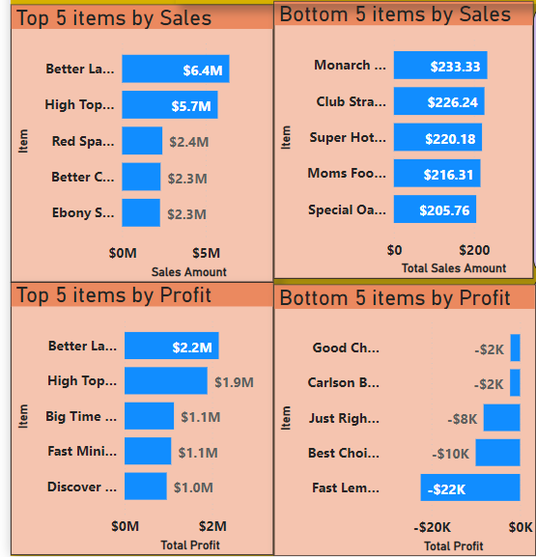

Slide 22

QUESTIONS AND ANSWERS
Q1) What’s thesource of data?
Ans)TheDataset was takenfromiNeuron’sProvidedProject DescriptionDocument.
https://drive.google.com/drive/folders/1FkmFVL8wlJmQWP1z52TD8PlhOJhitTyI?usp=sharing
Q2)Whatwas the type of data?
Ans)Thedata was a combination of numerical and Categorical values.
Q 3)What wasthe complete flowyou followed in thisProject?
Ans) Refer slide 5th for better Understanding Q4) What techniques were you using fordata? Ans) -Removingunwanted attributes.
-Visualizing relationof independentvariableswitheach otherand outputvariables.
-Checking and changing distribution of continuous values.
-Removing outliers
-Cleaningdata and imputingifnullvaluesare present.
-Transforming data to yield the desired result.

Slide 23
THANK YOU

